Slide 1
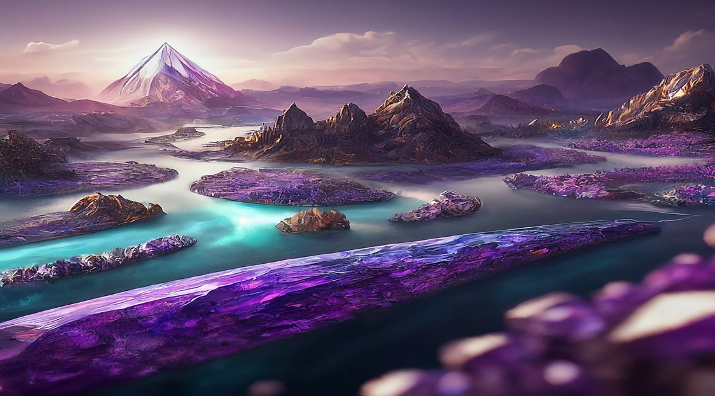


Slide 2



Members
SYCSB24
Jannu -41
Aniket Kalbhor -48
Karan Harshey -52
Prutha Pawade -89
Guide- Prof. Shailaja Uke
Vishwakarma Institute of Technology, Pune -37

Slide 3







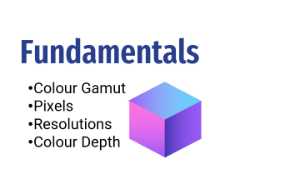





Slide 4


Introduction and Components

Slide 5
Introduction and Components
Computer graphics involves creating sketches, drawings, or special networks that visually represent meaningful information.
It finds applications where sets of images need to be manipulated or generated as pixels.
Extensively used in digital photography, film, entertainment, electronic devices, and core technologies.
As a vast and multifaceted field within computer science, computer graphics continues to play a crucial role in various domains.

Slide 6


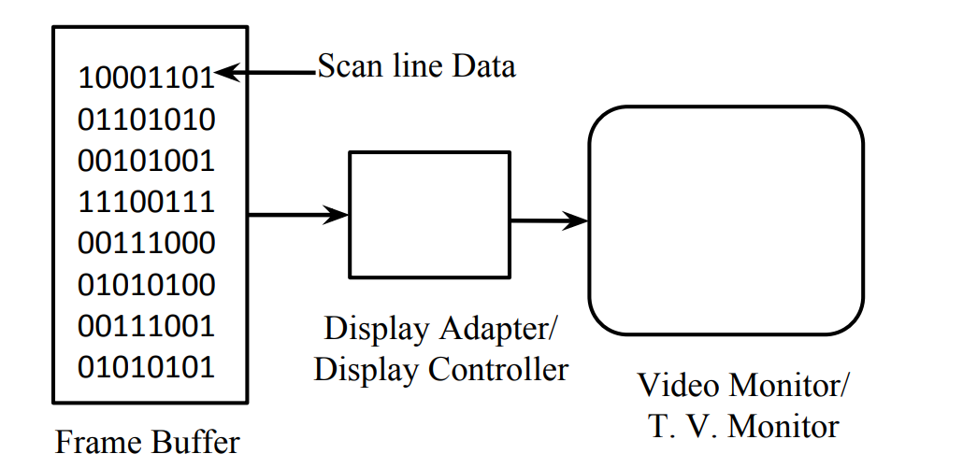
Types
Passive CG:
Non interactive
The picture is produced on monitor, user does not have control over the image.
2. Active CG:
Interactive
User can make changes in the produced image.
Components
Hardware:
Graphics Processing Unit (GPU): The powerhouse behind rendering images, responsible for processing and manipulating graphical data.
Monitor or Display Device: Where the final images are presented for users to see.
Software:
Modelling Software: Tools like Blender, Maya, or AutoCAD for creating 3D models.
Rendering Software: Programs like Pixar's RenderMan or NVIDIA's Mental Ray for generating photorealistic images from 3D models.
Image Editing Software: Familiar names like Adobe Photoshop or GIMP for editing and enhancing images.

Slide 7
Types
Passive CG:
Non interactive
The picture is produced on monitor, user does not have control over the image.
2.Active CG:
Interactive
User can make changes in the produced image.
Components
Hardware:
Graphics Processing Unit (GPU): The powerhouse behind rendering images, responsible for processing and manipulating graphical data.
Monitor or Display Device: Where the final images are presented for users to see.
Software:
Modelling Software: Tools like Blender, Maya, or AutoCAD for creating 3D models.
Rendering Software: Programs like Pixar's RenderMan or NVIDIA's Mental Ray for generating photorealistic images from 3D models.
Image Editing Software: Familiar names like Adobe Photoshop or GIMP for editing and enhancing images.

Slide 8
Graphics Pipeline

Slide 9
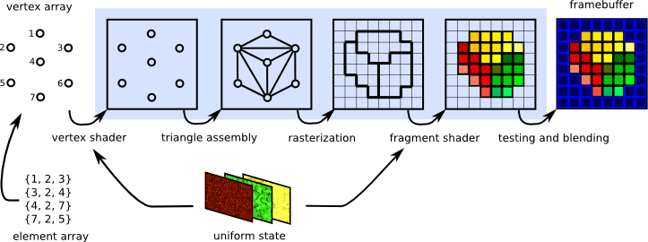
Graphics Pipeline

Slide 10
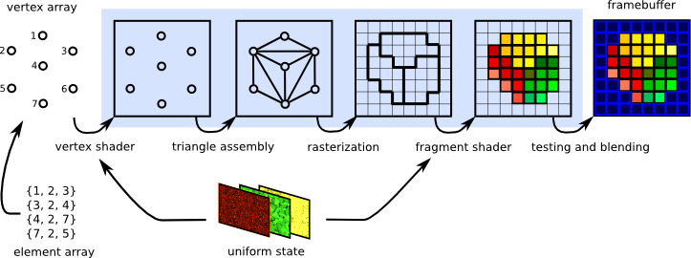
Graphics Pipeline
Vertex Shader

Slide 11
Graphics Pipeline
Vertex Shader
Triangle Assembly

Slide 12
Graphics Pipeline
Vertex Shader
Rasterization
Triangle Assembly

Slide 13
Graphics Pipeline
Vertex Shader
Rasterization
Triangle Assembly
Fragment Shader

Slide 14
Graphics Pipeline
Vertex Shader
Rasterization
Testing and Blending
Triangle Assembly
Fragment Shader

Slide 15
Graphics Pipeline
Vertex Shader
Rasterization
Testing and Blending
Triangle Assembly
Fragment Shader
Frame Buffer

Slide 16
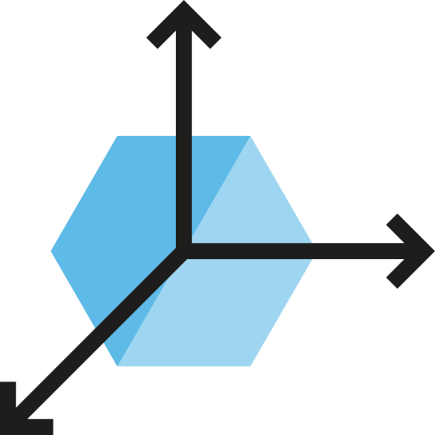
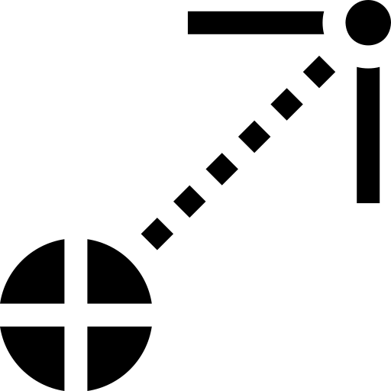

Cross and Dot Products

Slide 17
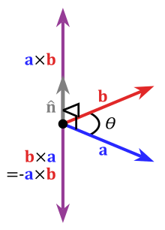
Physics Simulation
Calculating Surface Normals
Creating Coordinate Frames
Used to find a vector that is perpendicular to the surface - the normal vector.
Normals are key for lighting calculations, physics, and determining surface orientation.
Establish a local coordinate system on an object.
The cross product can generate the third perpendicular vector, completing the coordinate frame.
Useful for rotations and transformations within object space.
Physics calculations involving angular momentum or torque, particularly in 3D simulations.
Cross Product

Slide 18
Cross Product
Used to find a vector that is perpendicular to the surface - the normal vector.
Normals are key for lighting calculations, physics, and determining surface orientation.

Slide 19
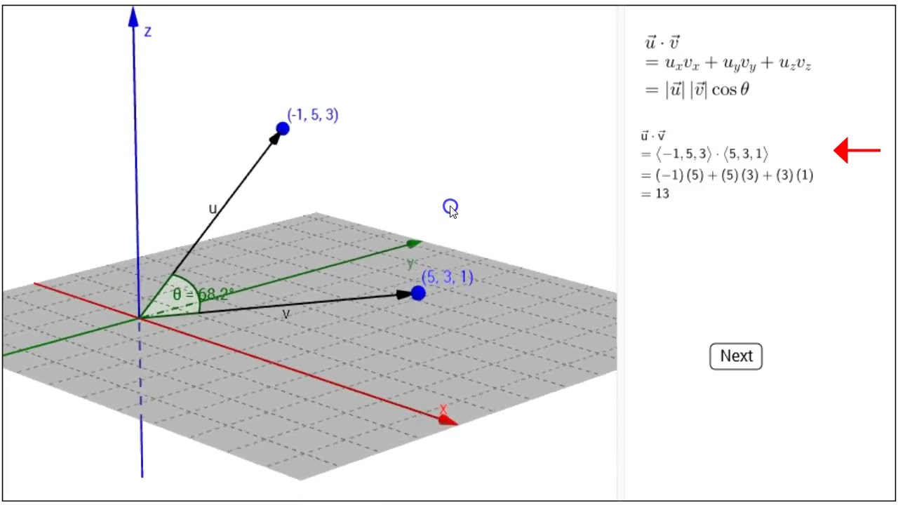
Dot Product
Lightning calculation
Vector Projection
Visibility Determination
The dot product is essential in calculating how light reflects off of surfaces (diffuse lighting models).
The angle between the surface normal (a vector perpendicular to the surface) and the light direction determines how much light is reflected and influences the final color of the object
The dot product can help determine if a point is in front of or behind a plane.
This is useful for blackface culling (discarding polygons not facing the camera, improving rendering performance) and in collision detection algorithms.
Used to project one vector onto another, which can be helpful in calculating shadows or simulating reflections.

Slide 20

Dot Product

Slide 21
Fundamentals
Colour Gamut
Pixels
Resolutions
Colour Depth

Slide 22
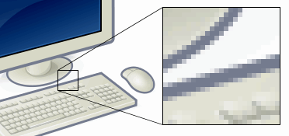
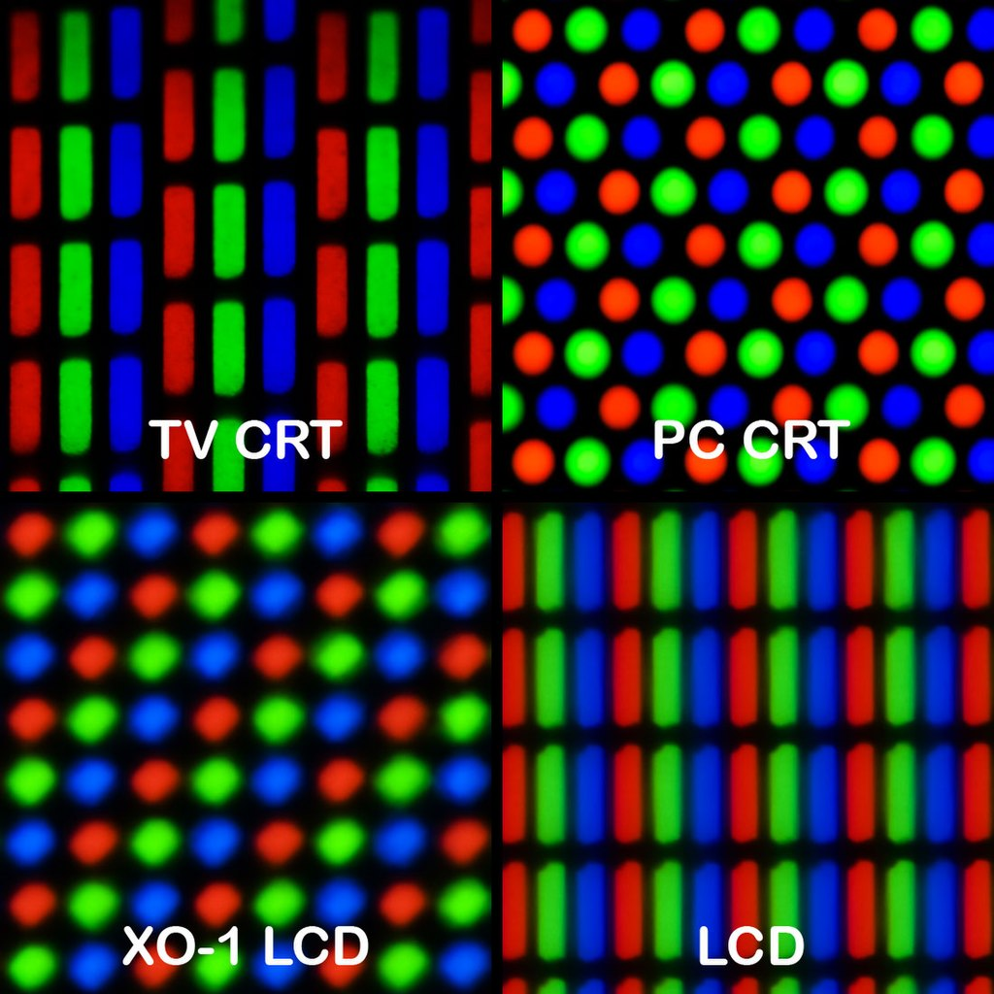
Pixels
In digital imaging, a pixel (abbreviated px),or picture element is the smallest addressable element in a raster image, or in a dot matrix display device.
Pixels are the smallest element that can be manipulated through software.
Saturn is the ringed planet and a gas giant
It’s the star at the centre of the Solar System

Slide 23
Pixels
In digital imaging, a pixel (abbreviated px),or picture element is the smallest addressable element in a raster image, or the smallest addressable element in a dot matrix display device.
In most digital display devices, pixels are the smallest element that can be manipulated through software.
Saturn is the ringed planet and a gas giant
It’s the star at the centre of the Solar System

Slide 24
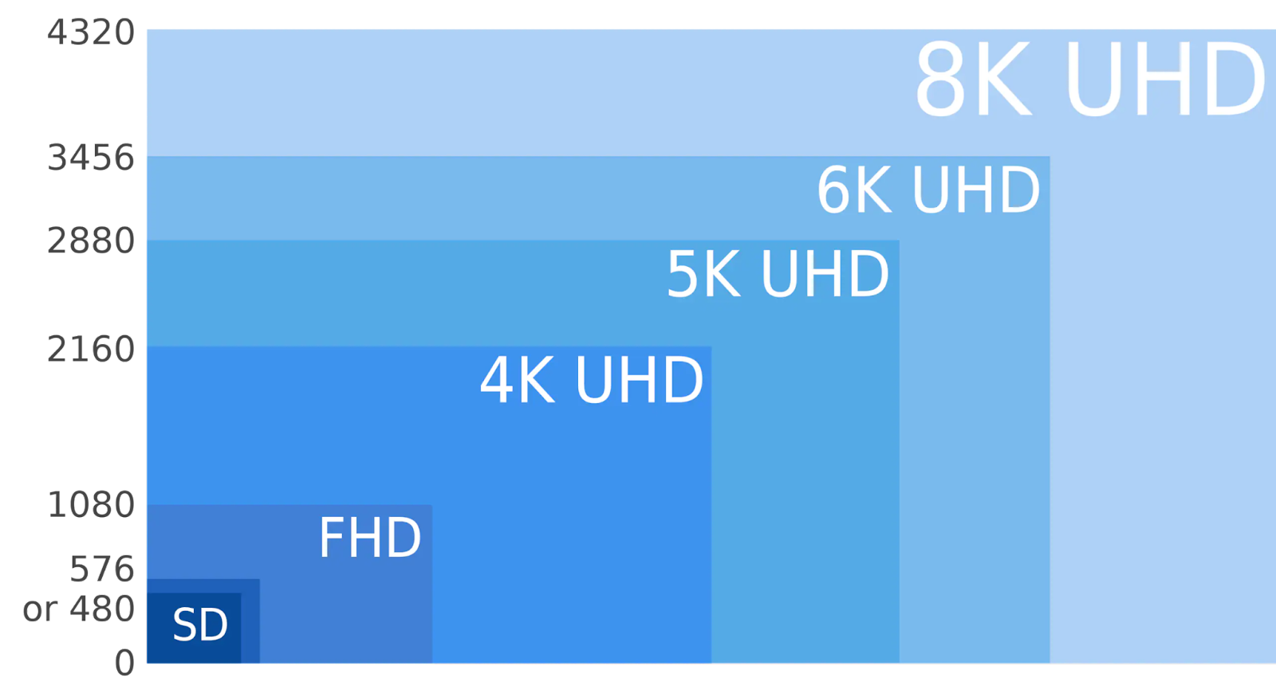
Resolution
The graphics display resolution is the width and height dimension of an electronic visual display device, measured in pixels.
This information is used for electronic devices such as a computer-monitor.
Pixel density != Resolution — pixel density describes the amount of detail on a physical surface or device, the resolution describes the amount of pixel information regardless of its scale.
Saturn is the ringed planet and a gas giant
It’s the star at the centre of the Solar System

Slide 25
Resolution
The graphics display resolution is the width and height dimension of an electronic visual display device, measured in pixels.
This information is used for electronic devices such as a computer-monitor.
Pixel density != Resolution — pixel density describes the amount of detail on a physical surface or device, the resolution describes the amount of pixel information regardless of its scale.
Saturn is the ringed planet and a gas giant
It’s the star at the centre of the Solar System

Slide 26
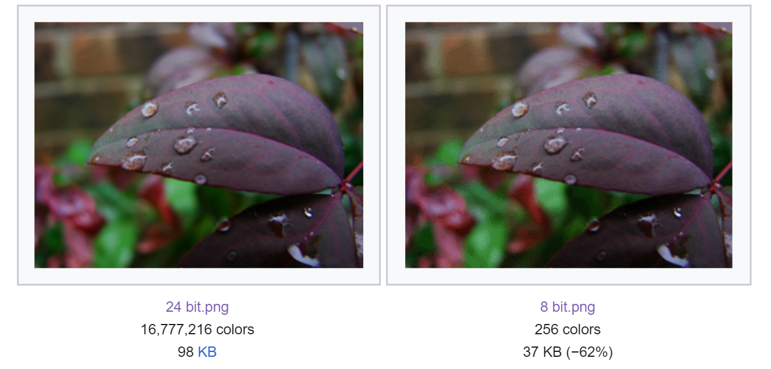
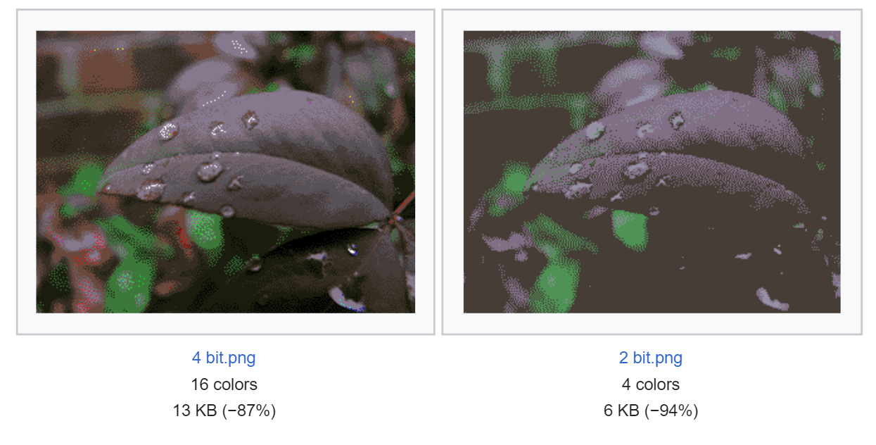
Colour Depth
Colour depth , also known as bit depth, is :
The number of bits used to indicate the colour of a single pixel
The number of bits used for each colour component of a single pixel.
Colour depth is the aspect of colour representation expressing the precision with which the amount of each primary can be expressed
The other aspect is how broad a range of colours can be expressed (the gamut).
The definition of both colour precision and gamut is accomplished with a colour encoding specification which assigns a digital code value to a location in a colour space.
Saturn is the ringed planet and a gas giant
It’s the star at the centre of the Solar System

Slide 27
Colour Depth
Saturn is the ringed planet and a gas giant
It’s the star at the centre of the Solar System

Slide 28
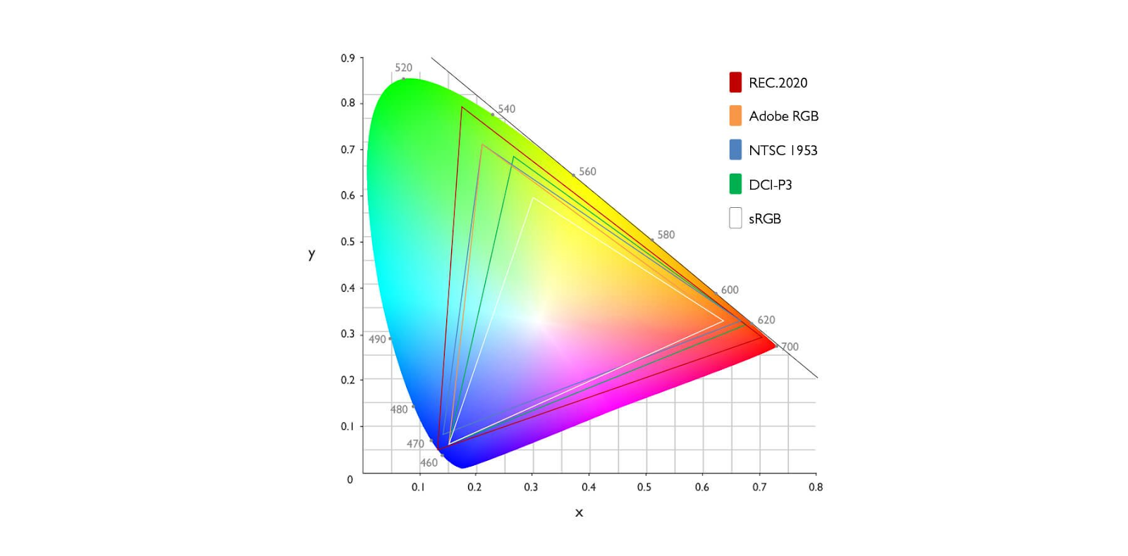
Colour Gamut
The colour gamut describes a range of colours within the spectrum of colours, or a colour space, that can be reproduced on an output device.
Saturn is the ringed planet and a gas giant
It’s the star at the centre of the Solar System

Slide 29
Display Technologies
CRT
LCD
LED
OLED

Slide 31





Slide 32
Cathode Ray Tube
LED
LCD
OLED

Slide 33
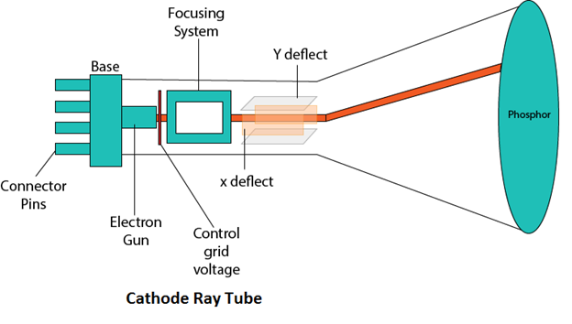
Cathode Ray Tube
CRT is an old technology which was used in displays.
The image on a CRT display is created by firing electrons from the electron gun, through the focusing system to the phosphorus coated screen.
It makes use of phosphorescence, which is the term used to characterize the light given off by a phosphor after it has been exposed to an electron beam.

Slide 34
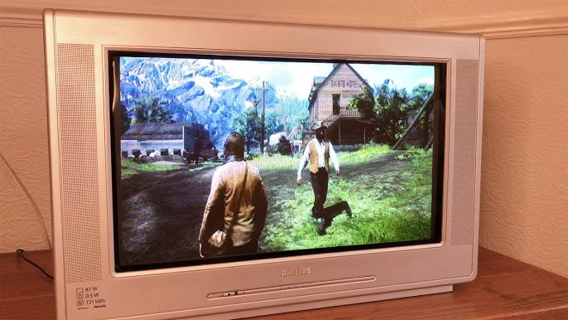

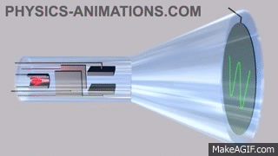
Cathode Ray Tube
CRT is an old technology which was used in displays.
The image on a CRT display is created by firing electrons from the electron gun, through the focusing system to the phosphorus coated screen.
It makes use of phosphorescence, which is the term used to characterize the light given off by a phosphor after it has been exposed to an electron beam.

Slide 35
Cathode Ray Tube

Slide 36
Cathode Ray Tube
LED
LCD
OLED

Slide 37
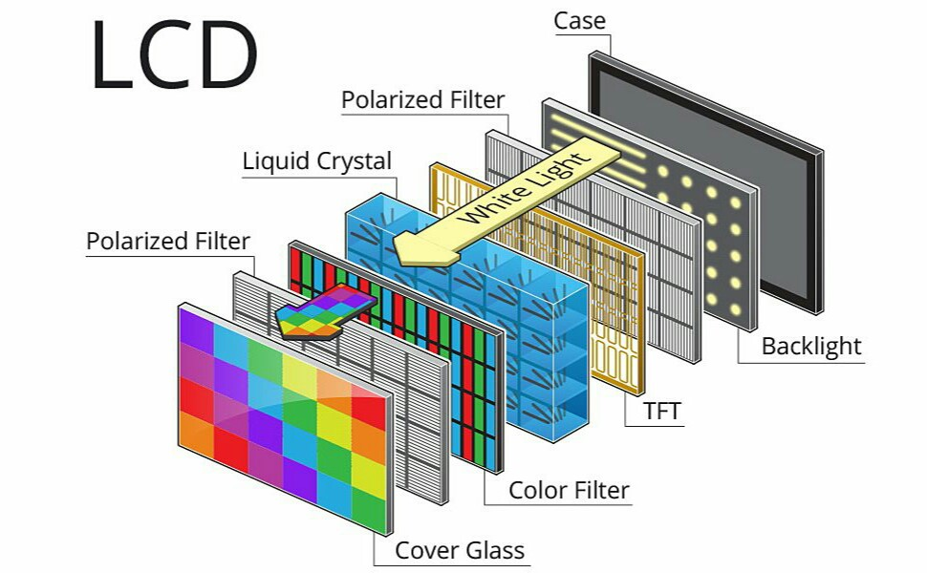
Liquid Crystal Display
This is a newer technology compared to CRT. An LCD display consists of millions of pixels made of crystals and arranged in a rectangular grid.
There is a common backlight which provides light to each pixel. Each pixel has an RGB subpixel, that can be turned on and off.
With all pixels turned on, we get white light. When all are turned off, we get black. We can gets sharper images with LCD.

Slide 38
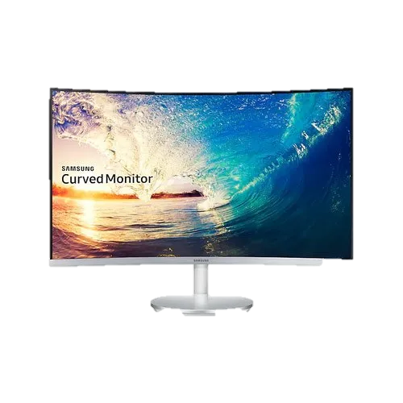

Liquid Crystal Display
This is a newer technology compared to CRT. An LCD display consists of millions of pixels made of crystals and arranged in a rectangular grid. There is a common backlight which provides light to each pixel. Each pixel has an RGB subpixel, that can be turned on and off. With all pixels turned on, we get white light. When all are turned off, we get black. We can gets sharper images with LCD.

Slide 39
Liquid Crystal Display
This is a newer technology compared to CRT. An LCD display consists of millions of pixels made of crystals and arranged in a rectangular grid. There is a common backlight which provides light to each pixel. Each pixel has an RGB subpixel, that can be turned on and off. With all pixels turned on, we get white light. When all are turned off, we get black. We can gets sharper images with LCD.

Slide 40
Cathode Ray Tube
LED
LCD
OLED

Slide 41
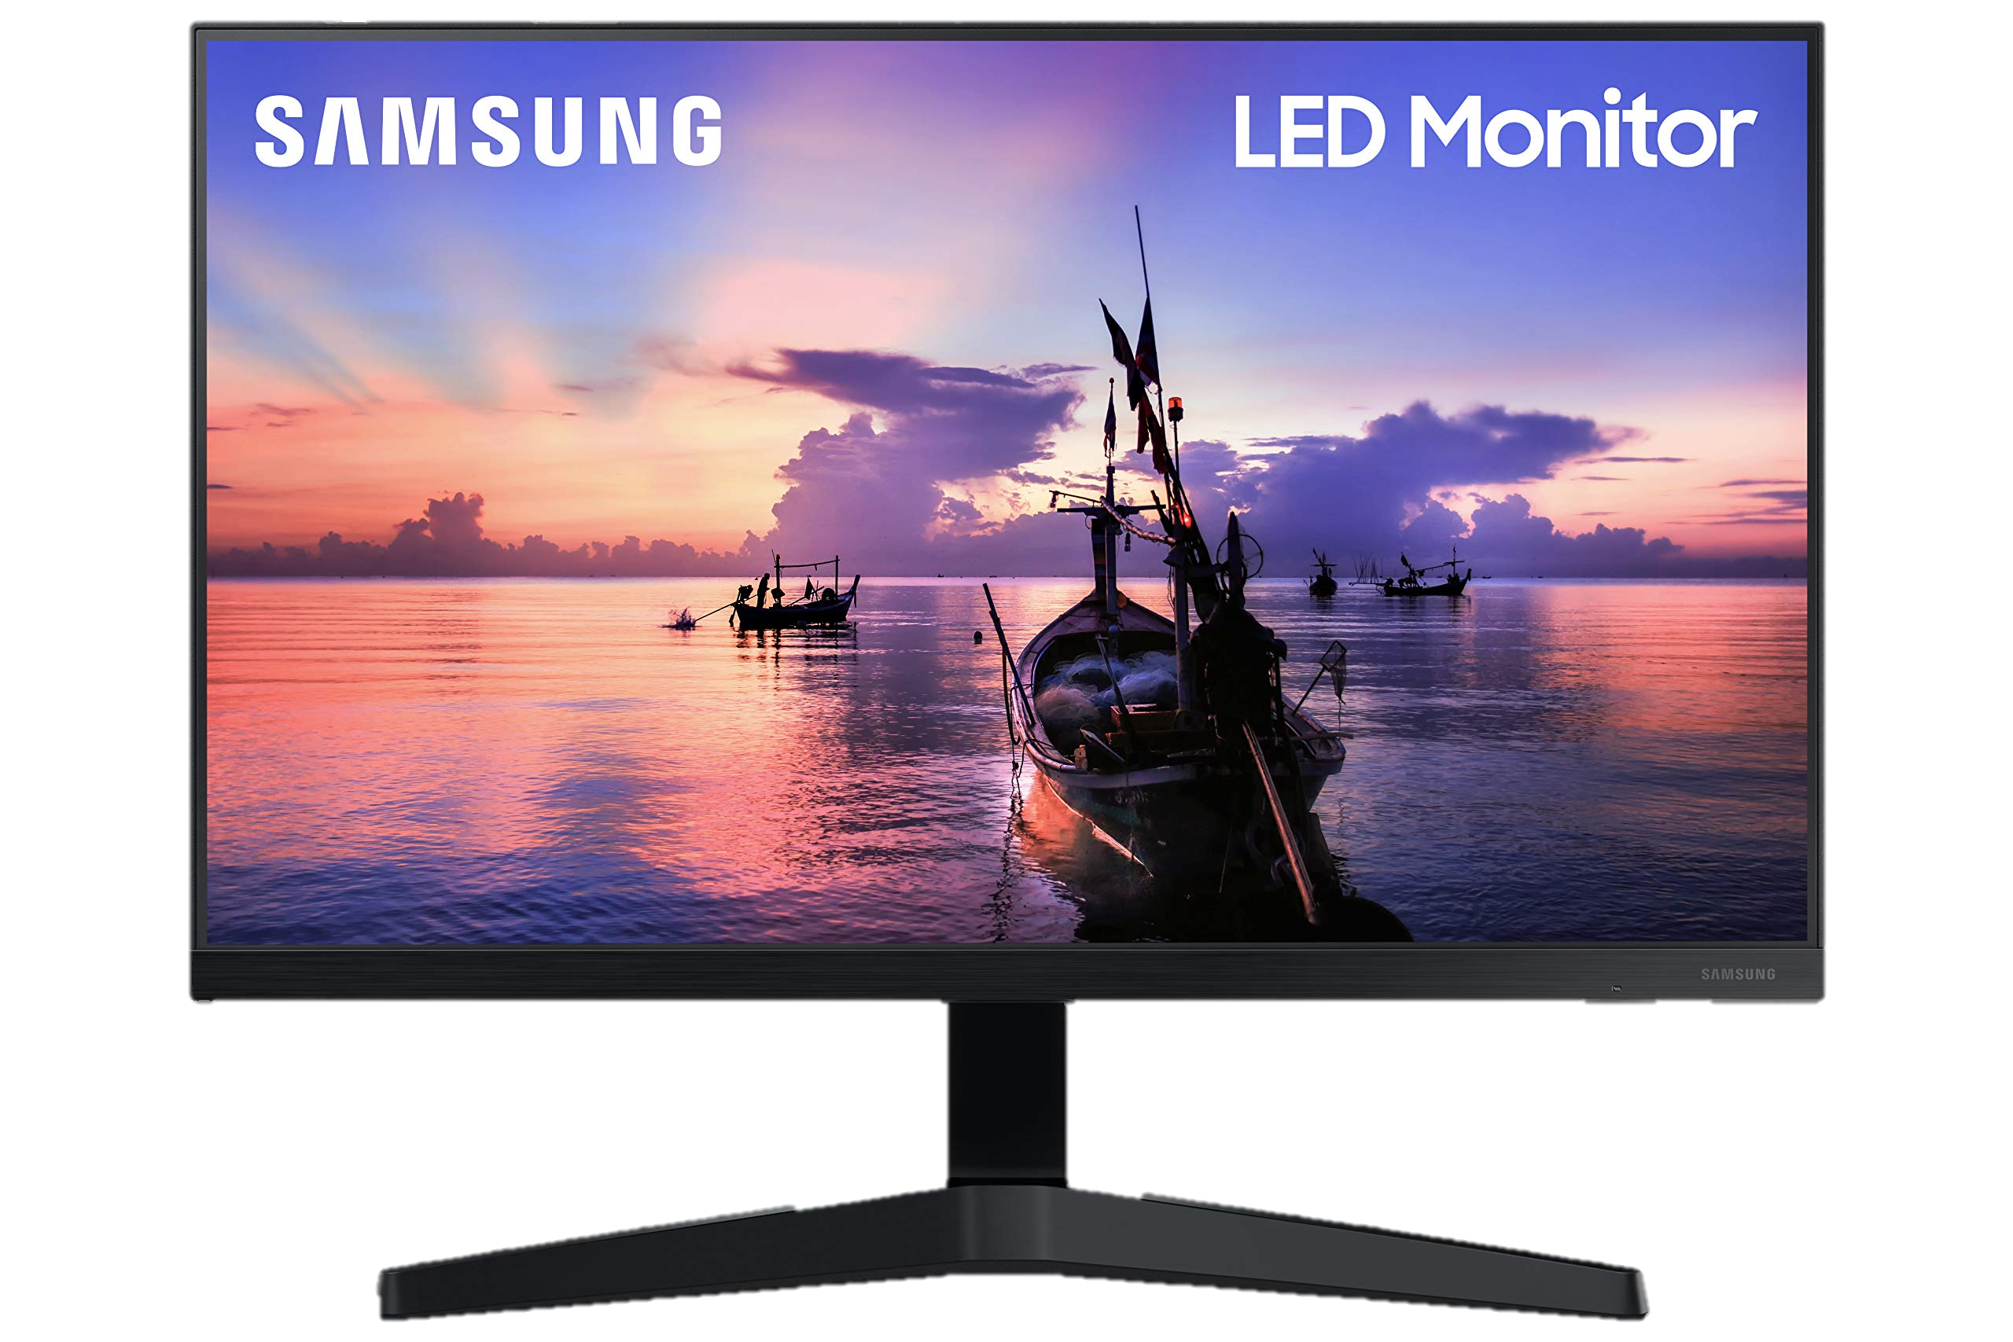
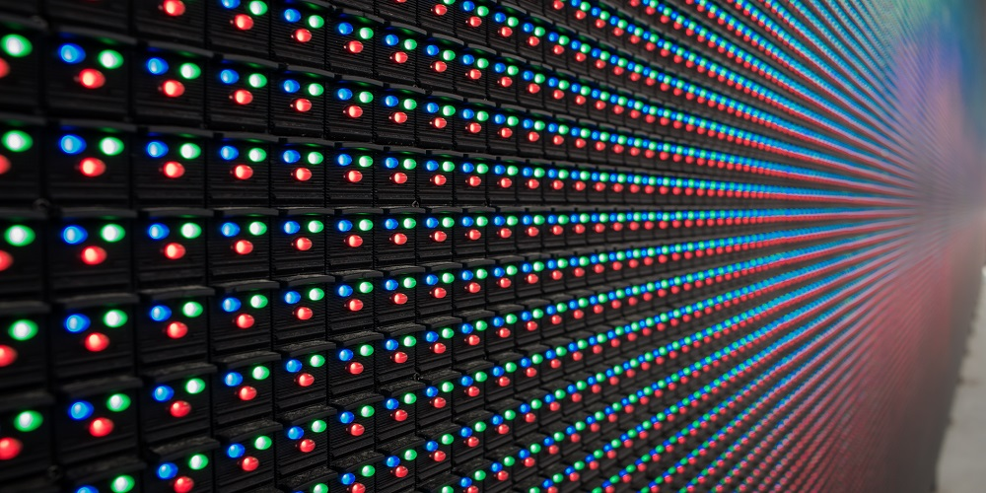
Light Emitting Diode
Consists of tiny little bulbs called diodes
Low power consumption
High brightness.
Capable of producing much higher contrast ratio, with black remaining true black because of the absence of back light.
Drawback- Brightness control, since the power given to a diode is also responsible for the colour reproduction, we can't simply lower the power supplied to diodes to control brightness.
Solution- Using PWM flicker in order to control the brightness, which may stress eyes.
this technology consists of tiny little bulbs called diodes. LED displays use a large number of these diodes. These diodes are low power consumption devices that provide high brightness. This technology is capable of producing much higher contrast ratio, with black remaining true black because of the absence of back light. One drawback is, however, the brightness control. Since the power given to a diode is also responsible for the colour reproduction, we cant simply lower the power supplied to diodes to control brightness, we need to use something called PWM flicker in order to control the brightness. This PWM may cause stress on some people’s eyes.

Slide 42
Light Emitting Diode
Consists of tiny little bulbs called diodes
Low power consumption
High brightness.
Capable of producing much higher contrast ratio, with black remaining true black because of the absence of back light.
Drawback- Brightness control, since the power given to a diode is also responsible for the colour reproduction, we can't simply lower the power supplied to diodes to control brightness.
Solution- Using PWM flicker in order to control the brightness, which may stress eyes.

Slide 43
Cathode Ray Tube
LED
LCD
OLED

Slide 44
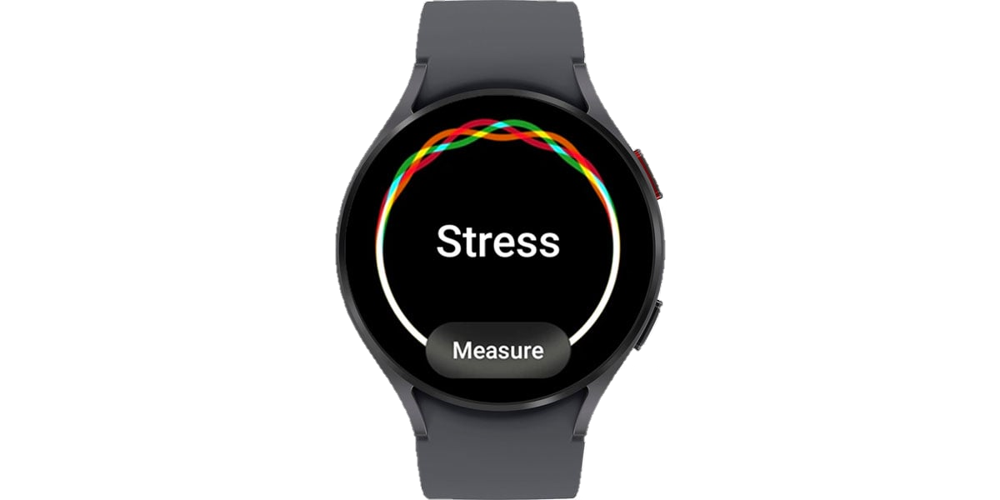
Organic LED
OLED is a further improvement upon the existing LED display technology, more reliable.
No excess heat produced
Lighter, brighter
Lesser power consumption compared to LEDs
Fastest response times as compared to all other display technologies.
Drawback- May have a smaller life as compared to LED.
this technology consists of tiny little bulbs called diodes. LED displays use a large number of these diodes. These diodes are low power consumption devices that provide high brightness. This technology is capable of producing much higher contrast ratio, with black remaining true black because of the absence of back light. One drawback is, however, the brightness control. Since the power given to a diode is also responsible for the colour reproduction, we cant simply lower the power supplied to diodes to control brightness, we need to use something called PWM flicker in order to control the brightness. This PWM may cause stress on some people’s eyes.

Slide 45
OLED
OLED is a further improvement upon the existing LED display technology, more reliable.
No excess heat produced
Lighter, brighter
Lesser power consumption compared to LEDs
Fastest response times as compared to all other display technologies.
Drawback- May have a smaller life as compared to LED.
this technology consists of tiny little bulbs called diodes. LED displays use a large number of these diodes. These diodes are low power consumption devices that provide high brightness. This technology is capable of producing much higher contrast ratio, with black remaining true black because of the absence of back light. One drawback is, however, the brightness control. Since the power given to a diode is also responsible for the colour reproduction, we cant simply lower the power supplied to diodes to control brightness, we need to use something called PWM flicker in order to control the brightness. This PWM may cause stress on some people’s eyes.

Slide 46
Cathode Ray Tube
LED
LCD
OLED

Slide 49
Rendering
Z Buffer
Scan Line
Ray Casting
Ray Tracing

Slide 50
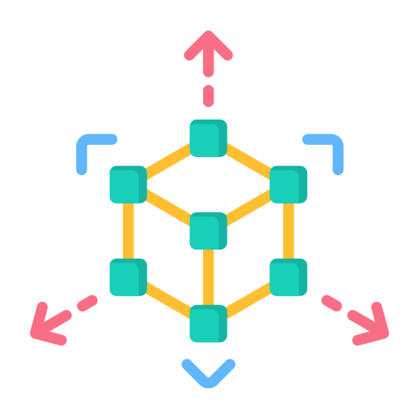


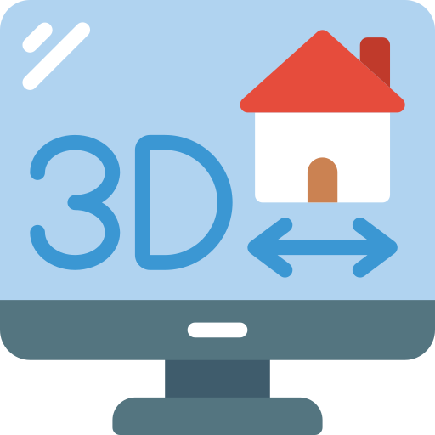

Rendering
Rendering is the process involved in the generation of a two dimensional or three dimensional image from a model, by means of a computer program.
There are two major types of renderings, divided on the speed at which the computation and finalization takes place.
Real time rendering:
Mainly used in gaming and interactive graphics, where images are calculated from 3D information at a very fast pace.
Requires dedicated graphics.
2. Pre - rendering:
Used in environments where speed isn’t a concern and image calculations are performed using multi core processor units.
Used for high photo-realism.

Slide 51
Rendering Techniques
Z Buffer
Ray casting
Scan Line
Ray Tracing

Slide 52
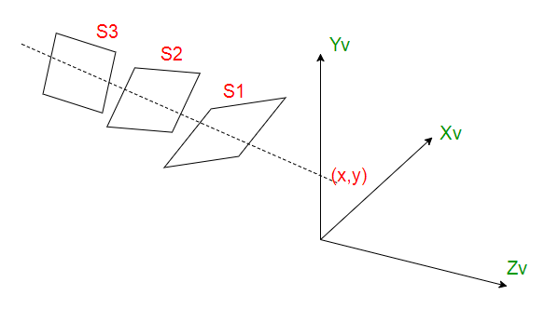
Z Buffer
It uses two data structures such:
Z-buffer (a memory area that keeps the z coordinate closest to the observer for each pixel)
Frame buffer (which contains the colour information to the pixels contained in the z buffer).
The largest z value is stored in the buffer. This value is updated only if the point in question has a larger z value than the one already in the buffer.

Slide 53
Rendering Techniques
Z Buffer
Ray casting
Scan Line
Ray Tracing

Slide 54
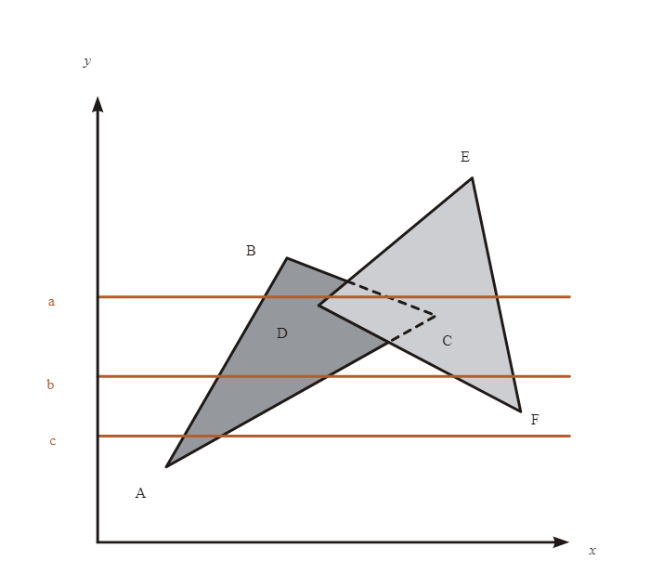
Scan Line
Used for determining visible surfaces.
It works by rendering the scene as a series of horizontal lines.
Employs a blend of algorithms for determining visible surfaces with determination of depth and shadows.
It differs from z- buffer in the sense that it works with one scan line at a time.

Slide 55
Rendering Techniques
Z Buffer
Ray casting
Scan Line
Ray Tracing

Slide 56
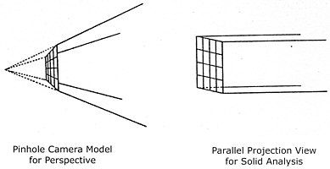
Ray Casting
In ray casting, a ray from the pixel through the camera is obtained and the intersection of all objects in the picture is computed.
The pixel value from the closest intersection is obtained and is further set as the base for projection
It is a faster way as compared to ray tracing, and less computationally intensive.

Slide 57
Rendering Techniques
Z Buffer
Ray casting
Scan Line
Ray Tracing

Slide 58
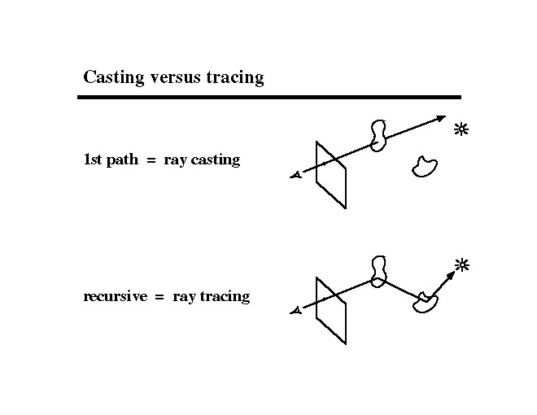
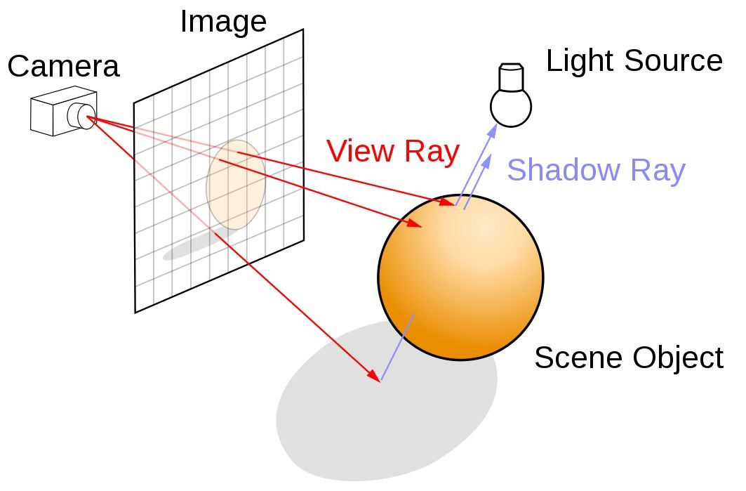
Ray Tracing
Ray tracing is a technique which can produce incredibly realistic lighting effects
It traces the path of light and then simulates how light interacts with virtual objects in the computer generated world.
This is more realistic compared to ray casting, however it requires a lot more computational power.

Slide 59
Ray Tracing
Ray tracing is a technique which can produce incredibly realistic lighting effects
It traces the path of light and then simulates how light interacts with virtual objects in the computer generated world.
This is more realistic compared to ray casting, however it requires a lot more computational power.

Slide 60
Rendering Techniques
Z Buffer
Ray casting
Scan Line
Ray Tracing

Slide 63
Anti-Aliasing

Slide 64


Anti-Aliasing
It is a technique used in computer graphics to remove the aliasing effect.
Aliasing effect- The appearance of jagged lines in a rasterized image. This effect occurs due to distortion of image when sampling is done at a low frequency.
Reason- Large difference between resolution of display and video
Saturn is the ringed planet and a gas giant
It’s the star at the centre of the Solar System

Slide 65
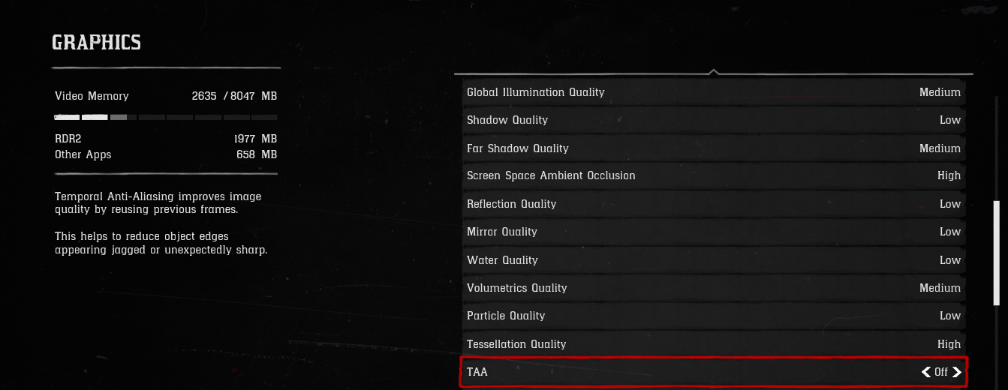
Saturn is the ringed planet and a gas giant
It’s the star at the centre of the Solar System

Slide 66
Saturn is the ringed planet and a gas giant
It’s the star at the centre of the Solar System

Slide 67
Use of Higher Resolution Display
Displaying objects at a higher resolution, the jagged edges become so small that they become indistinguishable for the human eye.
Thus, the jagged edges get blurred and appear smooth.
Area Sampling
Pixel Phasing
Determines the color or intensity of pixels based on the coverage of the pixel in the texture or object of that scene.
The scenario can be when pixels are overlapped
Pixel positions are shifted to nearly approximate positions of the virtual object geometry, thereby mitigating jagged lines.
Methods of Anti-Aliasing
Post Filtering (Super sampling)
Increase the sampling resolution of the screen by treating the screen as if its made of a finer grid of pixels, due to which the effective pixel size is reduced.
Thus, sampling is done at a higher resolution.
It’s the star at the centre of the Solar System

Slide 69











Slide 70
UI Designing

Slide 71
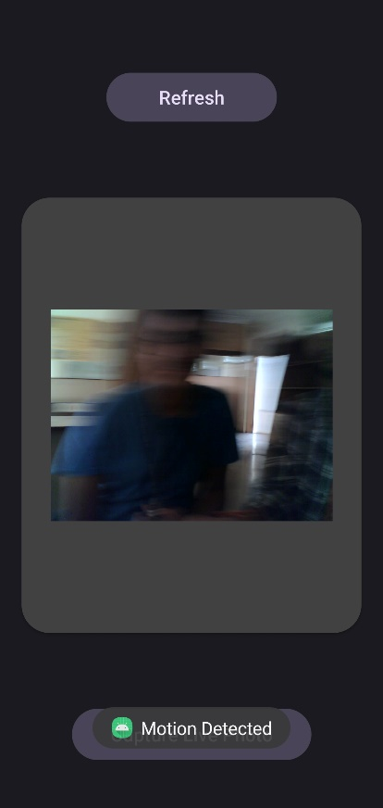

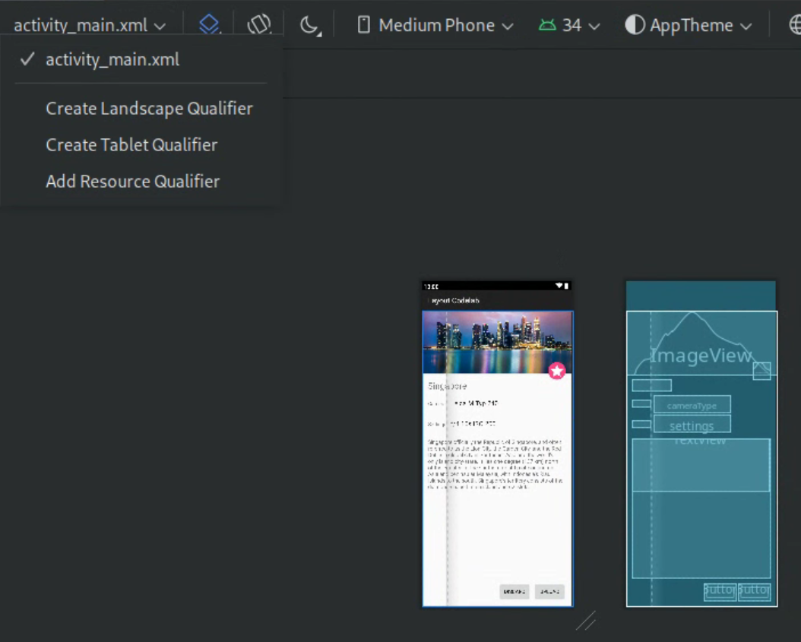

Slide 73
ROS-Gazebo

Slide 74
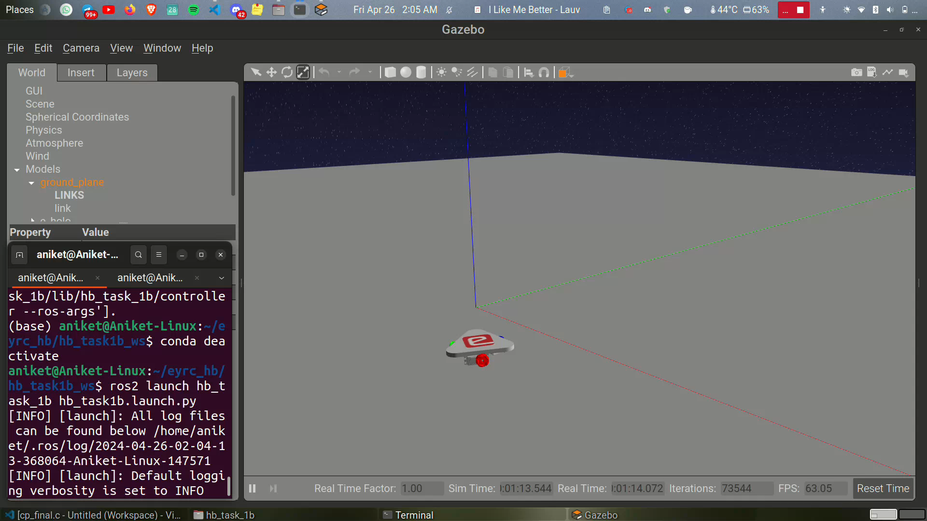

Slide 75
CAD Models

Slide 76
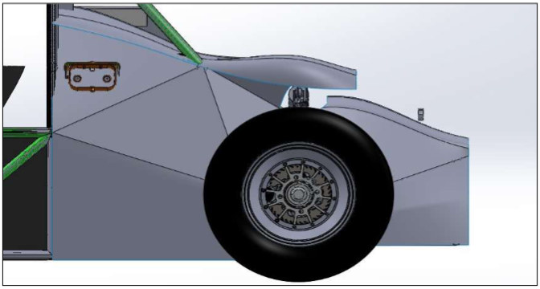
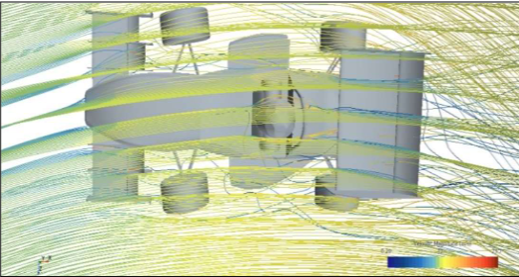
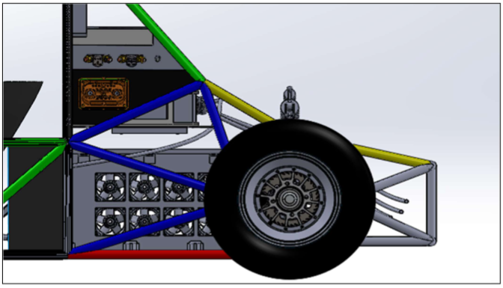
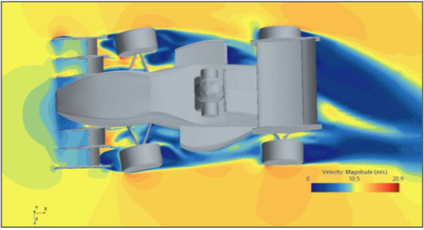

Slide 77
Gaming

Slide 79
Google Maps / Earth

Slide 81


REFERENCES
GeeksforGeeks
Medium CG
Michigan University
Harold Serrano
Medium Display Tech
3D Ace Studio
Nvidia

Slide 82
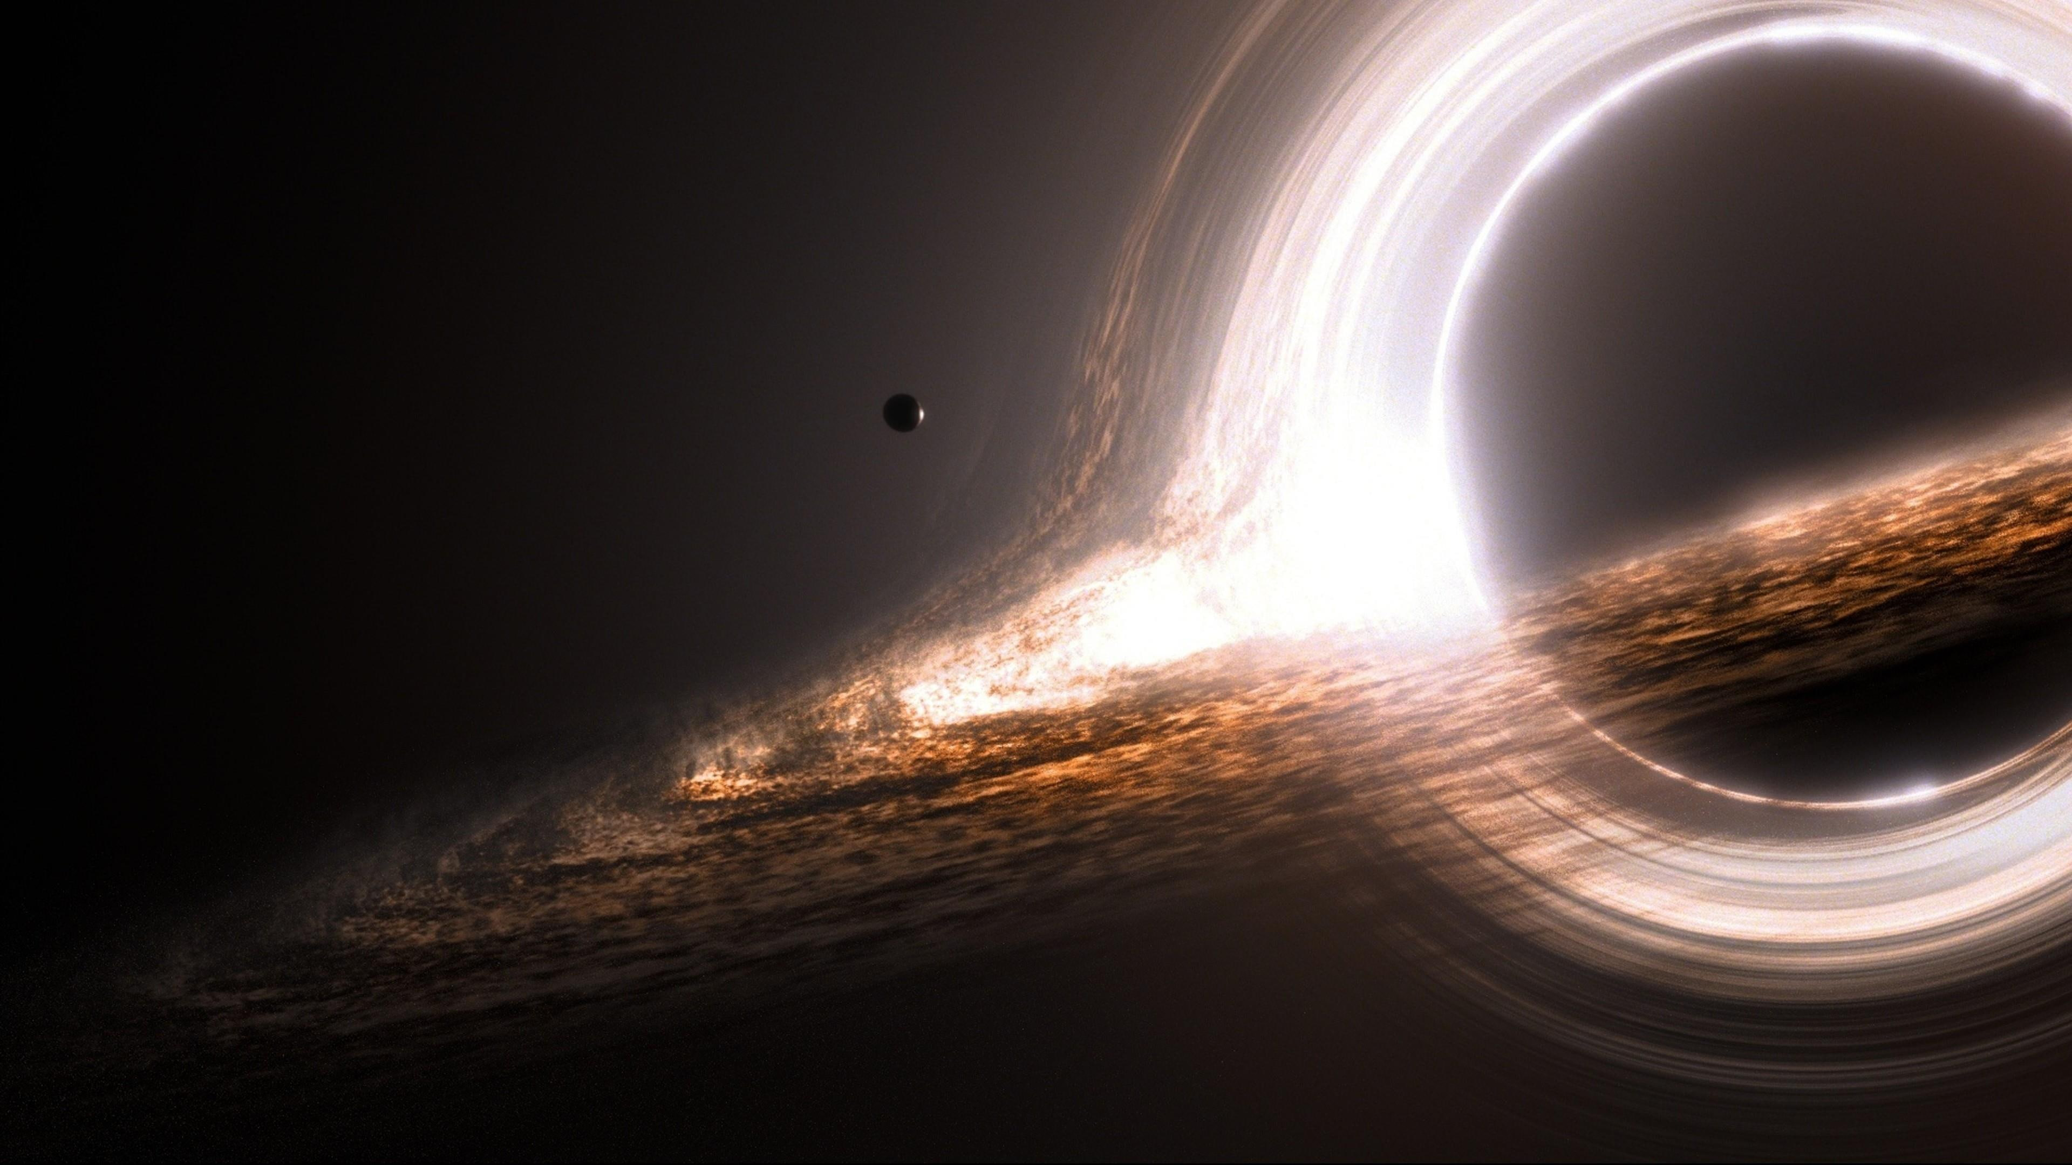
Core Concepts: Computer graphics rely on the manipulation of vertices, shapes, colors, and lighting to construct images and scenes.
Diverse Applications:
Entertainment (movies, games, animation)
Design and engineering (CAD, product visualization)
Education and training (simulations, visualizations)
Scientific exploration (data modeling, medical imaging)
The Future is Visual: Computer graphics continues to evolve, shaping how we communicate, create, and understand our world.

Slide 83
Core Concepts: Computer graphics rely on the manipulation of vertices, shapes, colors, and lighting to construct images and scenes.
Diverse Applications:
Entertainment (movies, games, animation)
Design and engineering (CAD, product visualization)
Education and training (simulations, visualizations)
Scientific exploration (data modeling, medical imaging)
The Future is Visual: Computer graphics continues to evolve, shaping how we communicate, create, and understand our world.

